Slide 1
Seguin ISD
Business Department
Financial Integrity Rating System (FIRST) of Texas
2022 -2023 Ratings
based on School Year 2021-2022 Data
Scoring:
  A - 90-100: Superior Achievement
  B - 80-89: Above Standard Achievement
  C - 60-79: Standard Achievement
  F - Below 60: Substandard Achievement

Slide 2
Seguin ISD
Business Department
Financial Integrity Rating System (FIRST) of Texas
Seguin ISD FIRST Results for 2022
The Indicators

Slide 3
Seguin ISD
Business Department
Financial Integrity Rating System (FIRST) of Texas
Indicator 1
Was the annual financial report filed within 30 days after the TEA set deadline of November 27?
Seguin ISD submitted AFR Nov 17
Score: Passed

Slide 4
Seguin ISD
Business Department
Financial Integrity Rating System (FIRST) of Texas
Indicator 2
Was there an unmodified opinion in the annual financial report on the financial statements as a whole?
Seguin ISD received an unmodified opinion
Score: Passed

Slide 5
Seguin ISD
Business Department
Financial Integrity Rating System (FIRST) of Texas
Indicator 3
Was the district in compliance with the payment terms of all debt agreements at fiscal year end?
Seguin ISD made all debt payments within the requirements of the bond covenants
Score: Passed

Slide 6
Seguin ISD
Business Department
Financial Integrity Rating System (FIRST) of Texas
Indicator 4
Did the district make timely payments to Teachers Retirement System, Texas Workforce Commission, Internal Revenue Service, and other government agencies?
Seguin ISD submitted timely reports and payments
Score: Passed

Slide 7
Seguin ISD
Business Department
Financial Integrity Rating System (FIRST) of Texas
Indicator 5
This indicator is not being scored.
Score: N/A
Notes:
school membership over 5 years was 7% or more - pass

Slide 8
Seguin ISD
Business Department
Financial Integrity Rating System (FIRST) of Texas
Indicator 6
Was the average change in fund balances over 3 years less than a 25% decrease or did the current year’s unassigned and assigned fund balances exceed 75 days of operational expenditures?
Seguin ISD met both criteria
Score: Passed

Slide 9
Seguin ISD
Business Department
Financial Integrity Rating System (FIRST) of Texas
Indicator 7
Was the number of days of cash on hand and current investments in the general fund for the school district sufficient to cover operating expenditures?
Seguin ISD had sufficient cash and investments
Score: 10 points

Slide 10
Seguin ISD
Business Department
Financial Integrity Rating System (FIRST) of Texas
Indicator 8
Was the measure of current assets to current liabilities ratio for the school district sufficient to cover short-term debt?
Current Assets: $87,938,648
Current Liabilities: $22,569,649
Ratio: 3.8963
Score: 10 points

Slide 11
Seguin ISD
Business Department
Financial Integrity Rating System (FIRST) of Texas
Indicator 9
Did the school district’s general fund revenues equal or exceed expenditures? Or, was the district’s number of days of cash on hand greater than or equal to 60 days?
Seguin ISD number of days of cash on hand was 182
Score: 10 points

Slide 12
Seguin ISD
Business Department
Financial Integrity Rating System (FIRST) of Texas
Indicator 10
This indicator is not being evaluated.
Score: 10 points
Notes:
15% decline in student/staff ratio

Slide 13
Seguin ISD
Business Department
Financial Integrity Rating System (FIRST) of Texas
Indicator 11
Was the ratio of long-term liabilities to total assets for the school district sufficient to support long-term solvency?
2022 Total Students: 7,039
2018 Total Students: 7,446
5 Year Change in Students: -407
Score: 4 points (points deducted for decrease in student enrollment

Slide 14
Seguin ISD
Business Department
Financial Integrity Rating System (FIRST) of Texas
Indicator 12
Was the debt per $100 of assessed property value ration sufficient to support future debt repayments?
Seguin ISD resources were sufficient to meet required debt service
Score: 8 points (point reduction due to additional bond debt)

Slide 15
Seguin ISD
Business Department
Financial Integrity Rating System (FIRST) of Texas
Indicator 13
Was the district’s administrative cost ratio equal to or less than the threshold ratio?
Recommended Administrative Cost Ratio: <= 10.00%
Seguin ISD Administrative Cost Ratio: 11.24%
Score: 8 points

Slide 16
Seguin ISD
Business Department
Financial Integrity Rating System (FIRST) of Texas
Indicator 14
This indicator is not being evaluated.
Score: 10 points

Slide 17
Seguin ISD
Business Department
Financial Integrity Rating System (FIRST) of Texas
Indicator 15
This indicator is not being evaluated.
Score: 5 points
Notes:
adjusted fsp for financial hardship

Slide 18
Seguin ISD
Business Department
Financial Integrity Rating System (FIRST) of Texas
Indicator 16
Did the comparison of PEIMS data to like information in the annual financial report result in a total variance of less than 3% of all expenditures by function?
Sum of Differences $104
Expenditures: $62,438,500
Score: Passed

Slide 19
Seguin ISD
Business Department
Financial Integrity Rating System (FIRST) of Texas
Indicator 17
Did the external independent auditor indicate the annual financial statement was free of any instance(s) of material weaknesses in internal controls over financial reporting and compliance for local, state, or federal funds?
Seguin ISD external auditor strong internal control
Score: Passed

Slide 20
Seguin ISD
Business Department
Financial Integrity Rating System (FIRST) of Texas
Indicator 18
Did the external auditor indicate the annual financial report was free of any instance(s) of material noncompliance for grants, contracts, and laws related to local, state or federal funds?
Seguin ISD AFR indicated no material noncompliance
Score: 10 points

Slide 21
Seguin ISD
Business Department
Financial Integrity Rating System (FIRST) of Texas
Indicator 19
Did the district post the required financial information on its website in accordance with Government Code, Local Government Code, Texas Education Code, Texas Administrative Code and other statues, laws, and rules were in effect at the district's fiscal year end?
Seguin ISD met all requirements
Score: 5 points

Slide 22
Seguin ISD
Business Department
Financial Integrity Rating System (FIRST) of Texas
Indicator 20
Did the school board members discuss the district’s property values at the board meeting within 120 days before the district adopted its budget?
Seguin ISD met all requirements
Score: Passed
Notes:
When was this discussed?

Slide 23
Seguin ISD
Business Department
Financial Integrity Rating System (FIRST) of Texas
Seguin ISD FIRST Results for 2022
90 out of 100 points
A - Superior Achievement

Slide 24
Seguin ISD
Business Department
Financial Integrity Rating System (FIRST) of Texas
4 Year Score Comparison

Slide 25
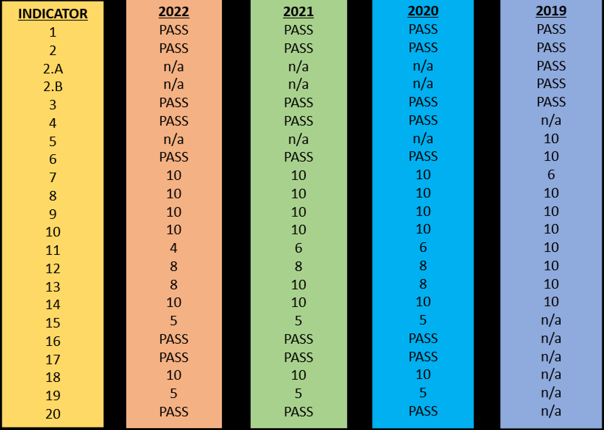
Seguin ISD
Business Department
Financial Integrity Rating System (FIRST) of Texas
90
94
92
96

Slide 26
Seguin ISD
Business Department
Financial Integrity Rating System (FIRST) of Texas
Required Disclosure:
Reimbursements Received by Superintendent & Board Members for Fiscal Year 2022

Slide 27
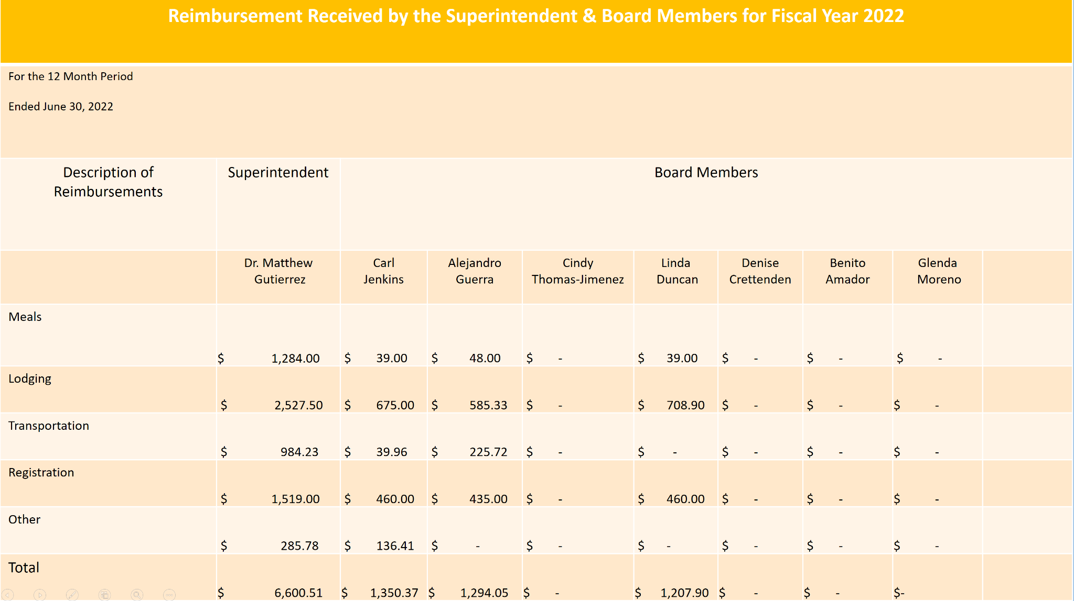
Seguin ISD
Business Department
Financial Integrity Rating System (FIRST) of Texas
Required Disclosure

Slide 28
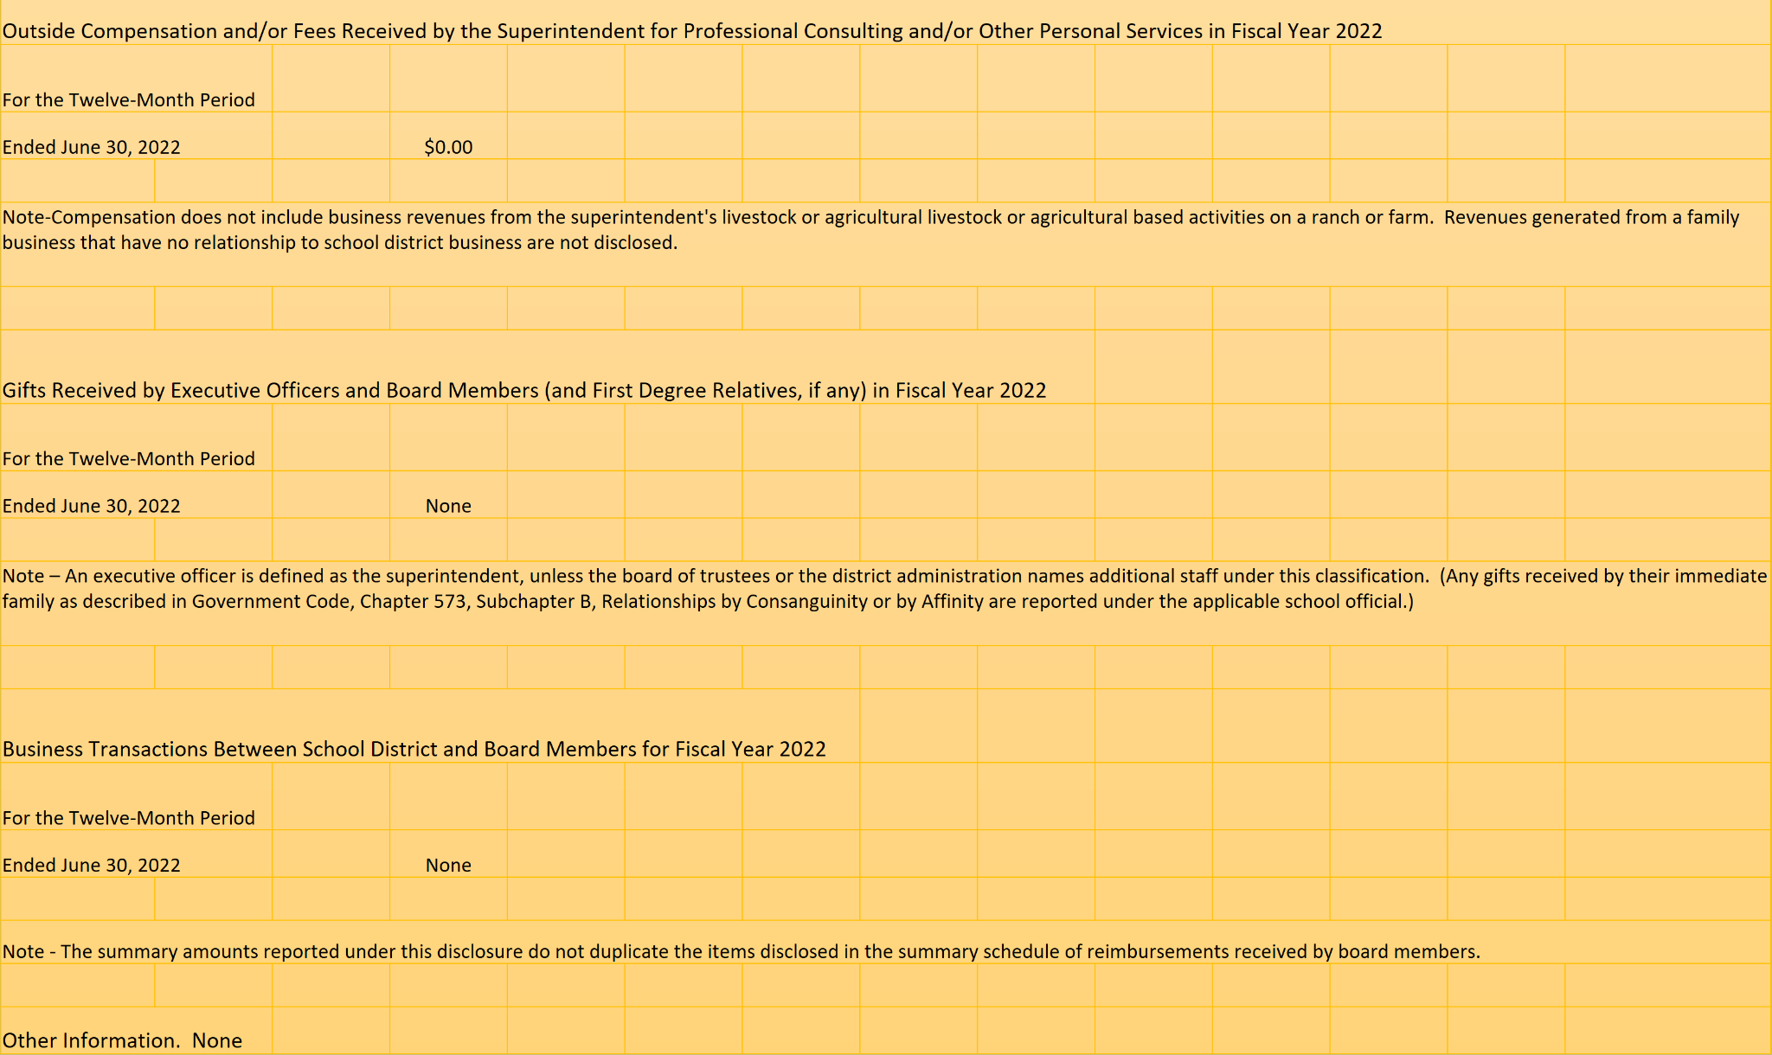
Seguin ISD
Business Department
Financial Integrity Rating System (FIRST) of Texas
Required Disclosure:
Reimbursements Received by Superintendent & Board Members for Fiscal Year 2022

Slide 29
Seguin ISD
Business Department
Financial Integrity Rating System (FIRST) of Texas
Required Disclosure:
Local Government Officer Conflicts Disclosure Statement

Slide 30
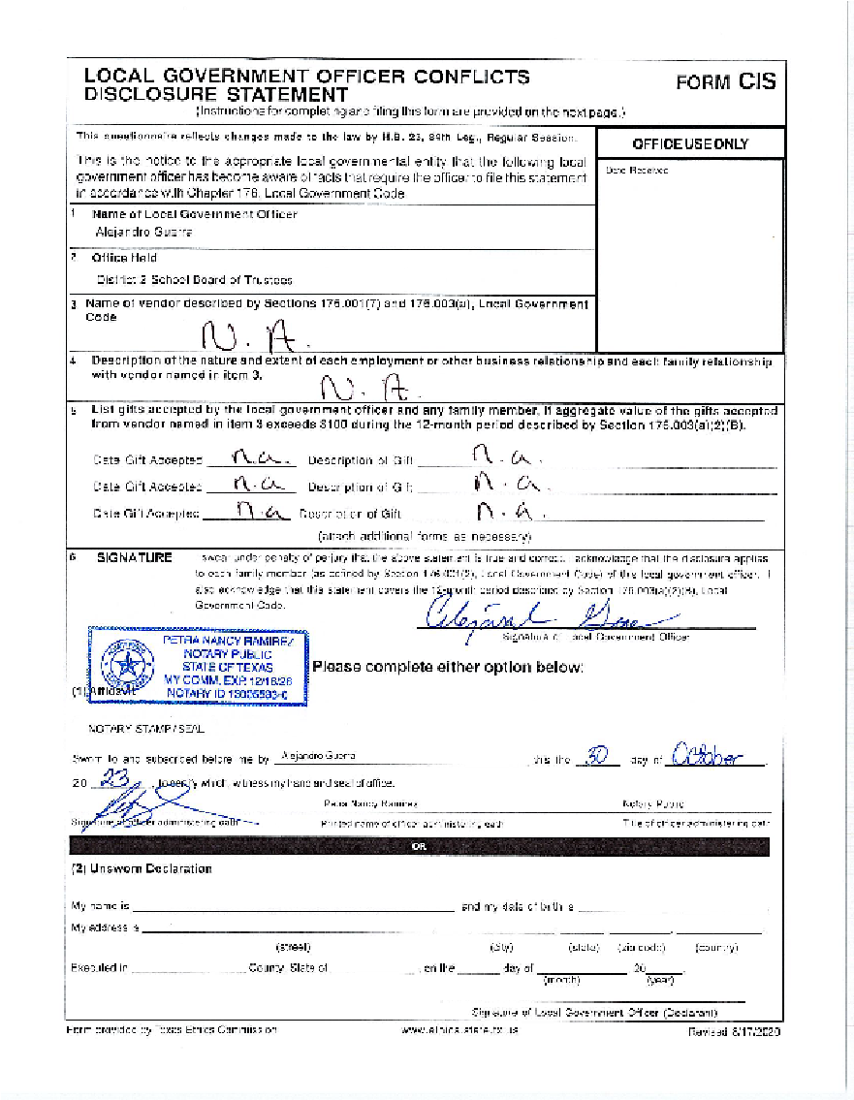
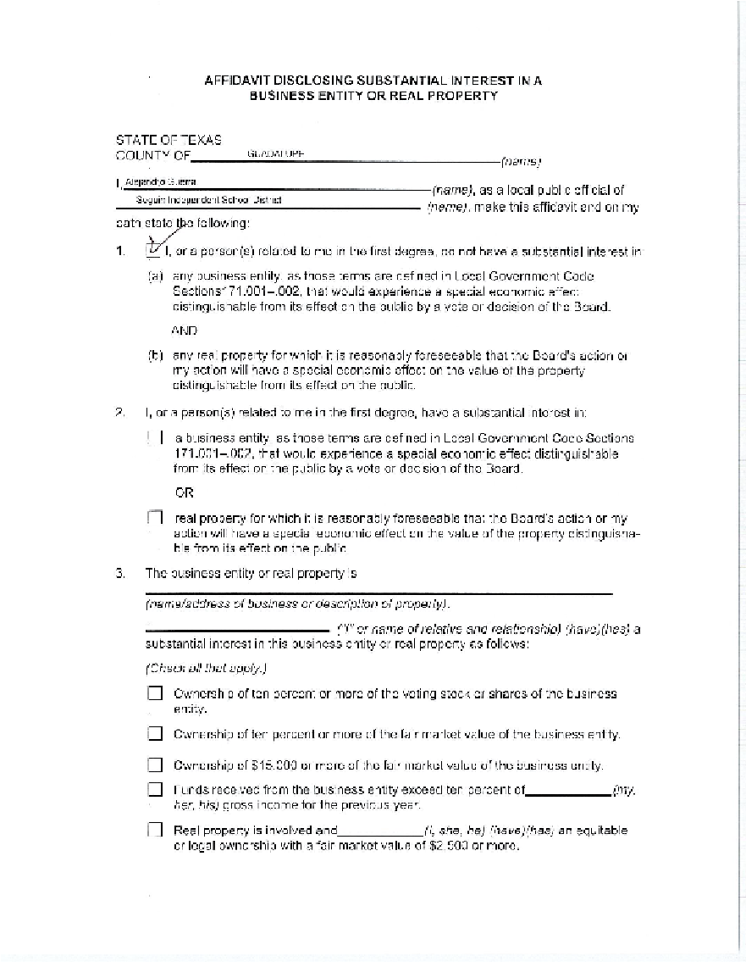
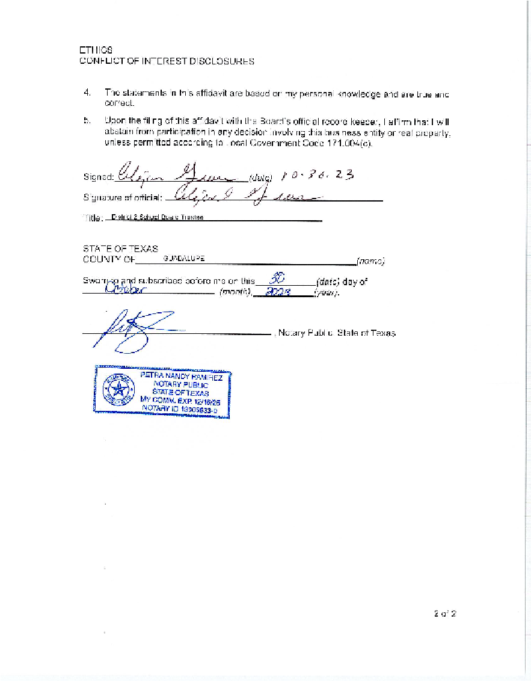
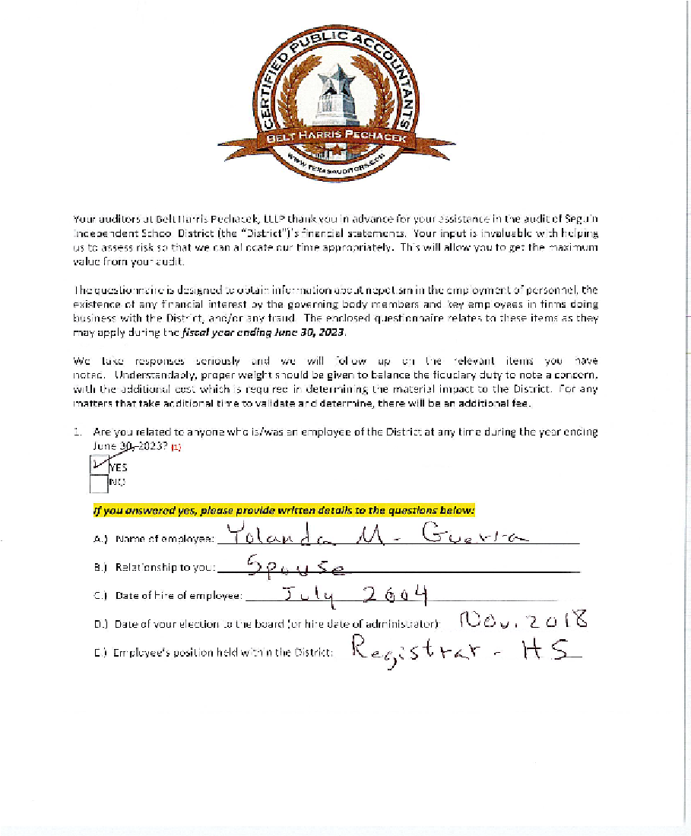
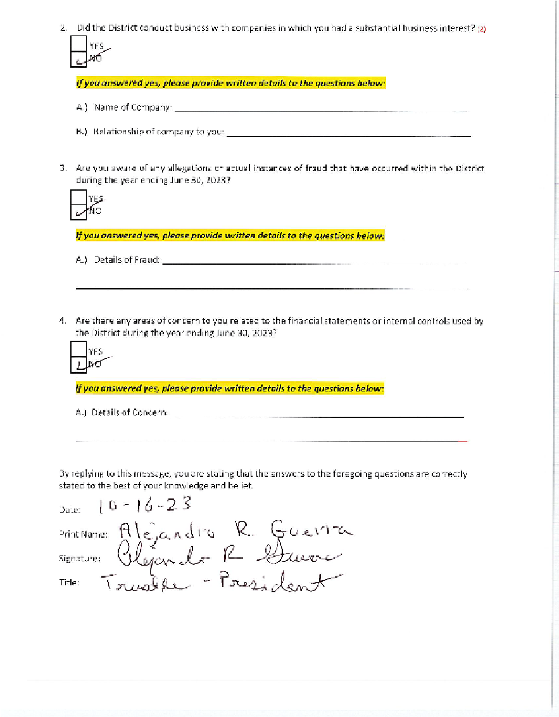
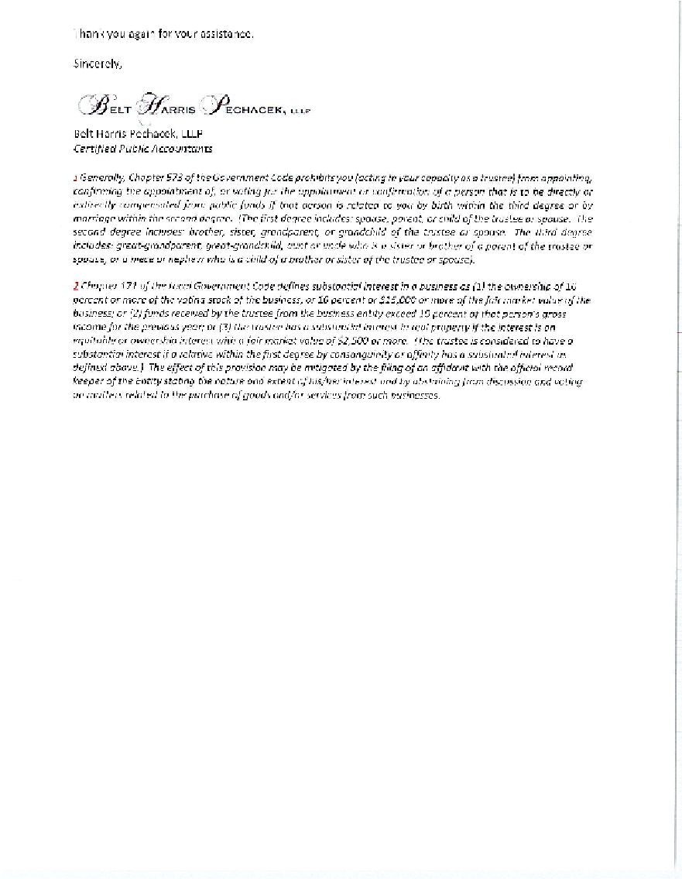

Slide 31
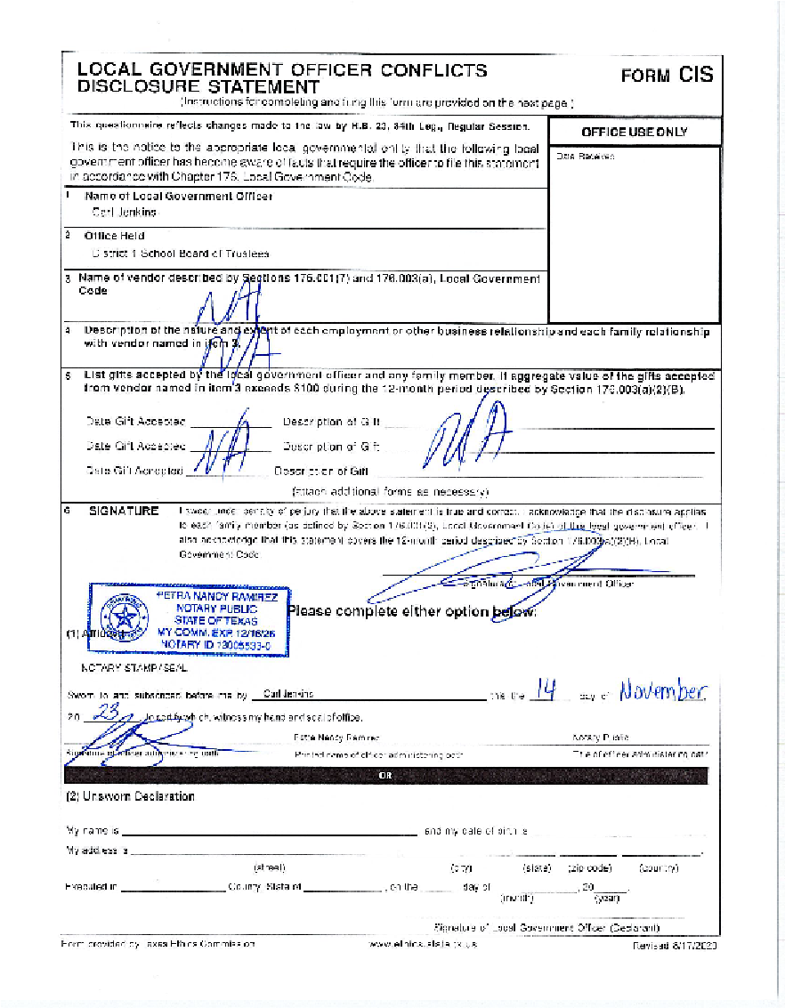
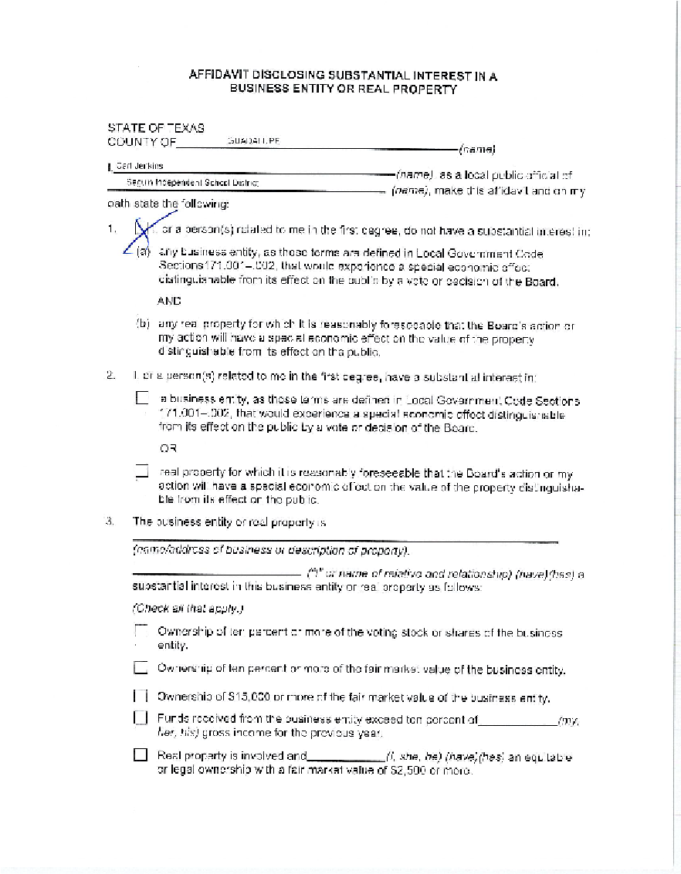
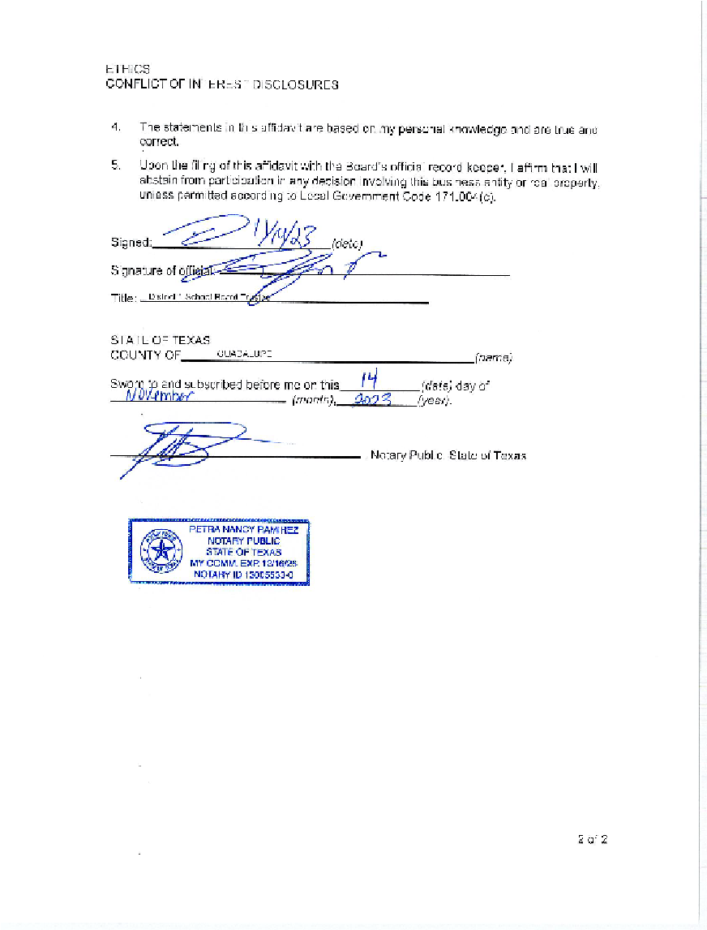
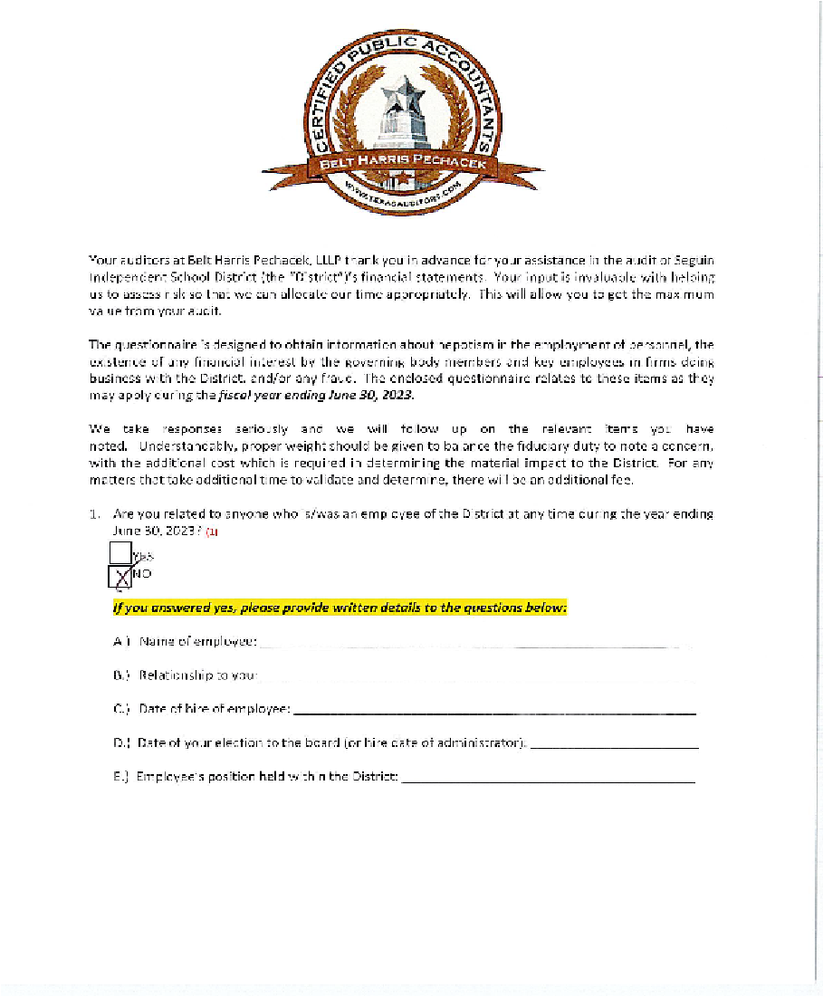
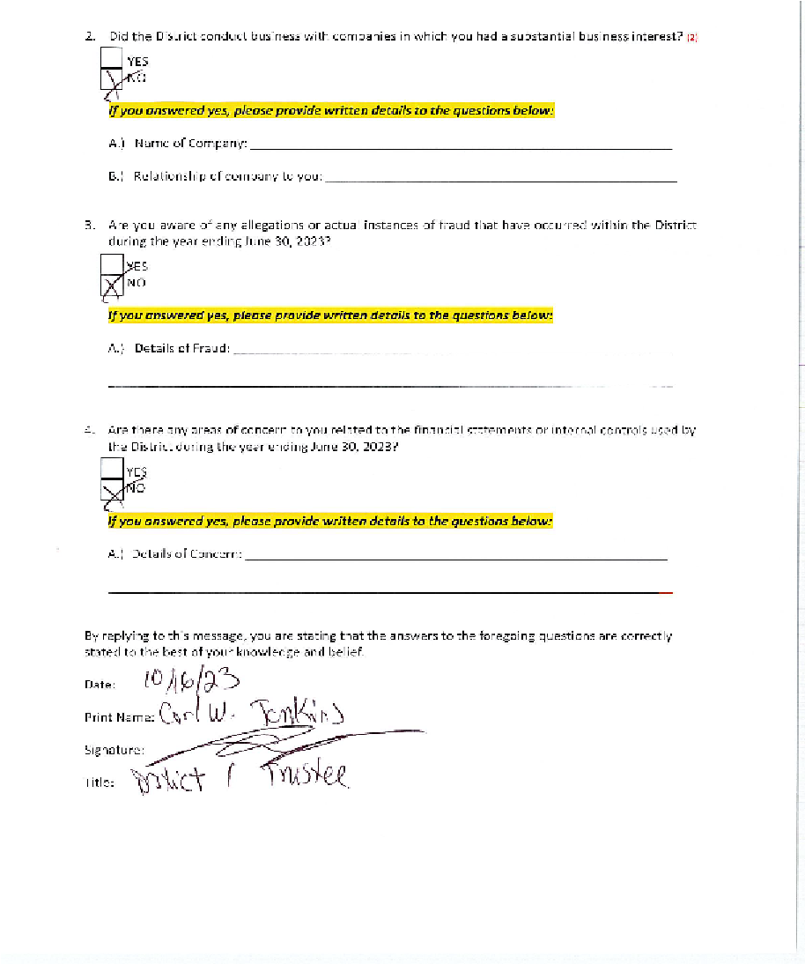
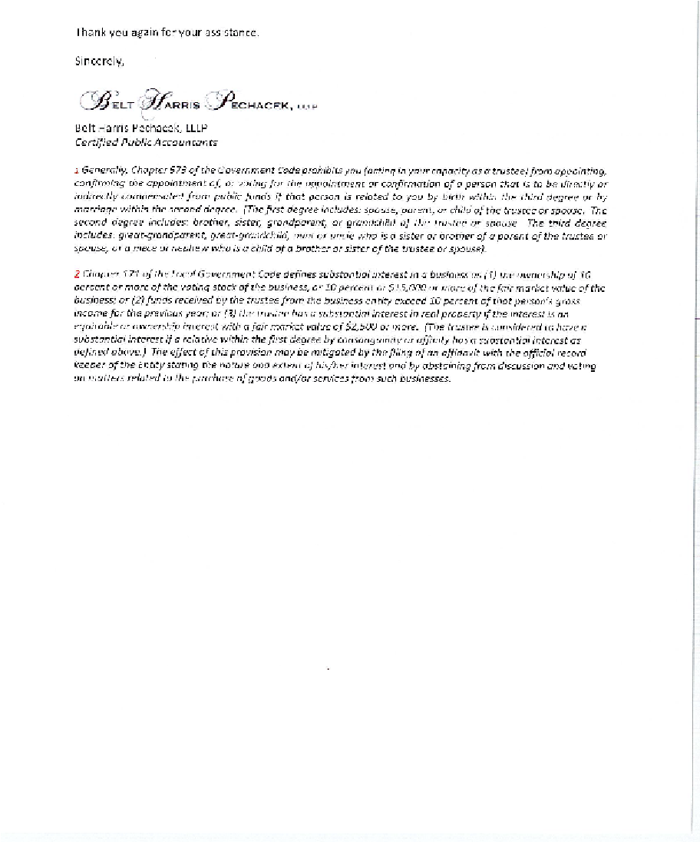

Slide 32
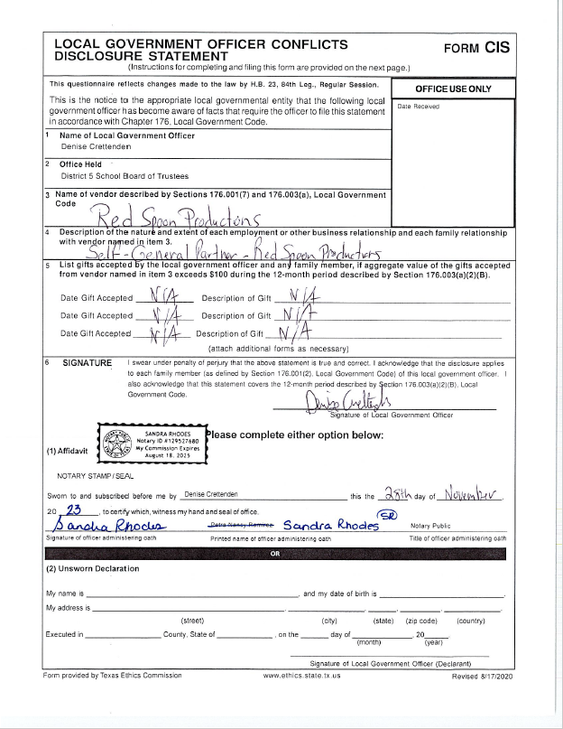
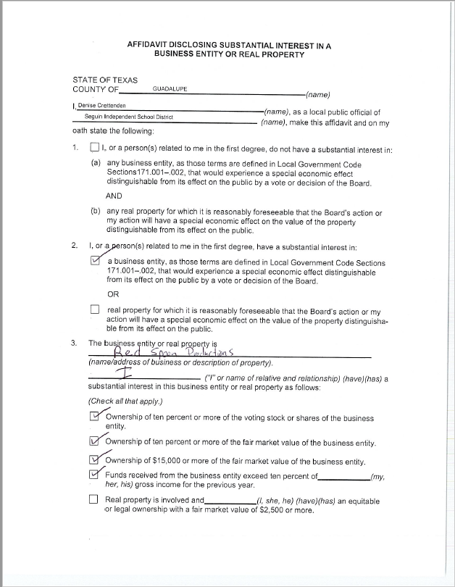
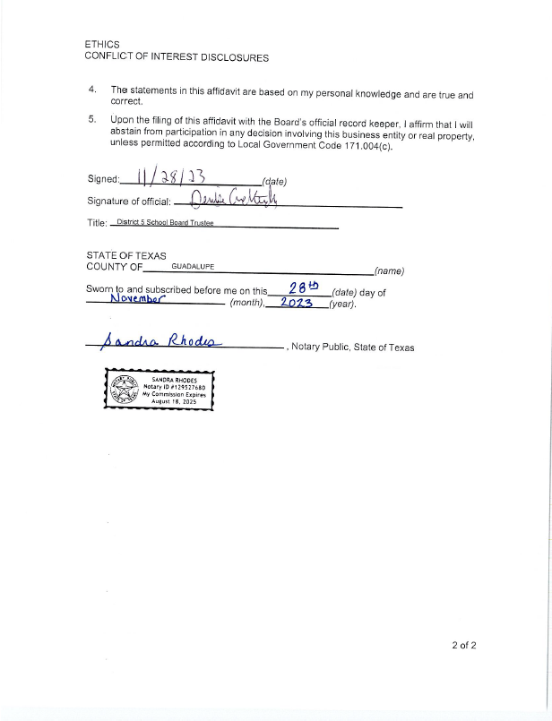
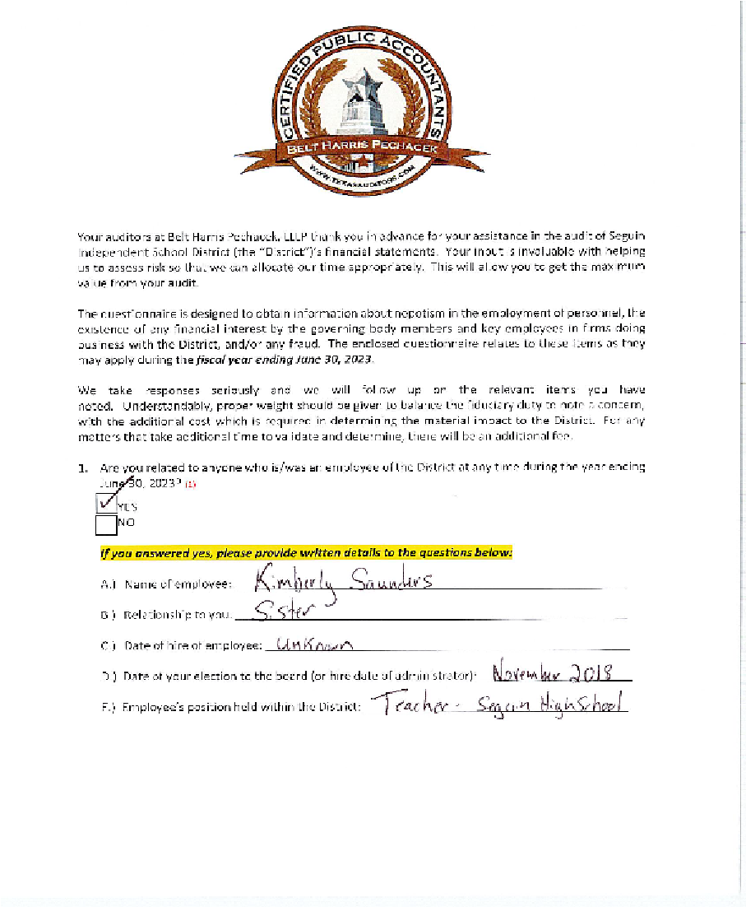
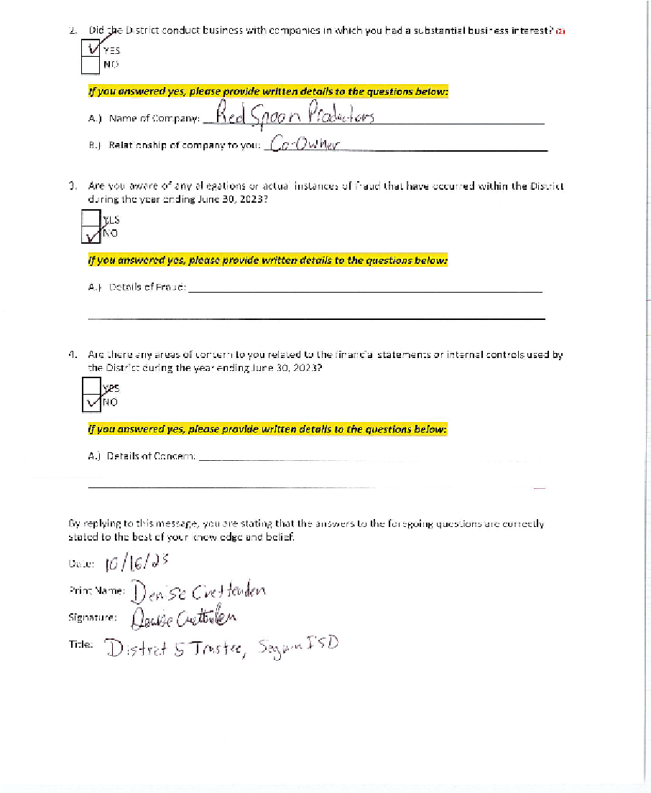
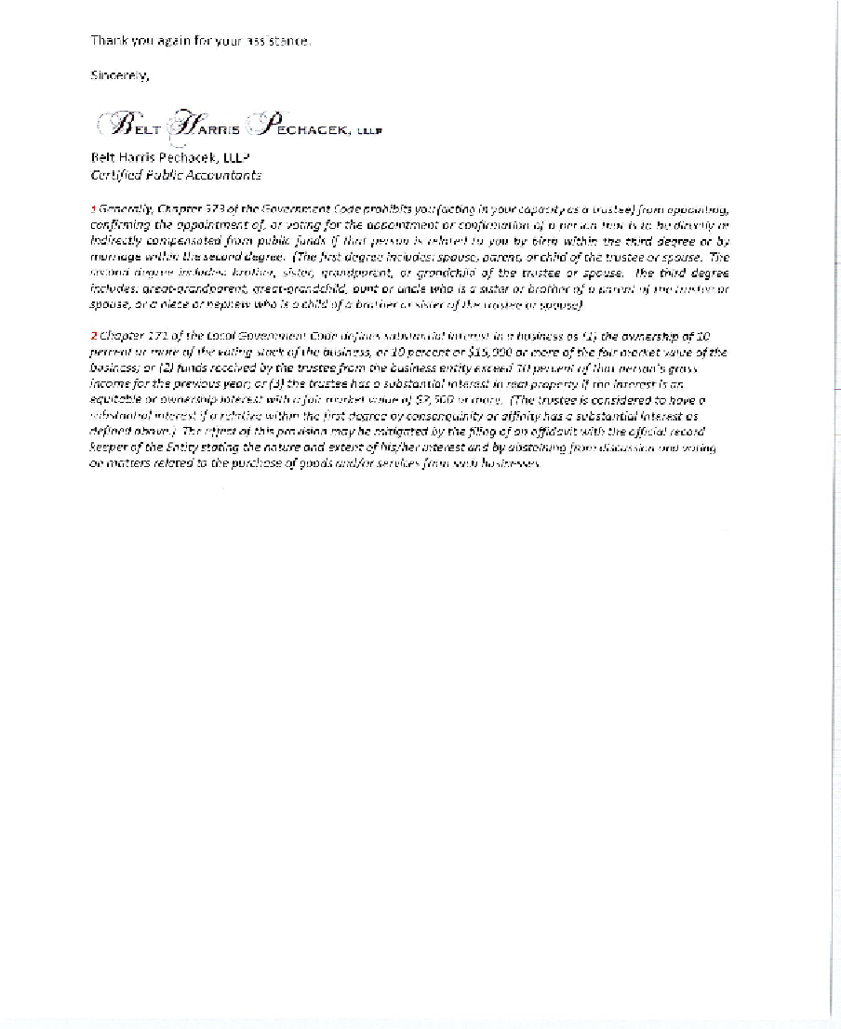

Slide 33
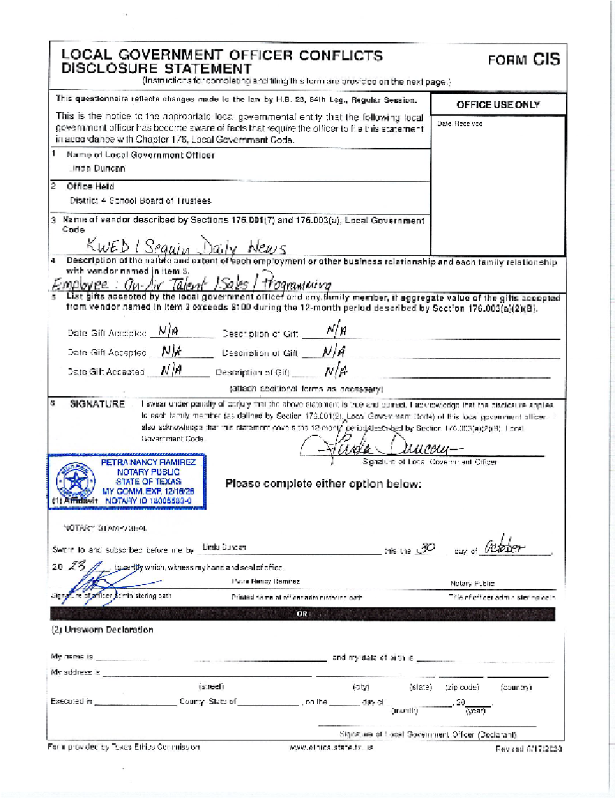
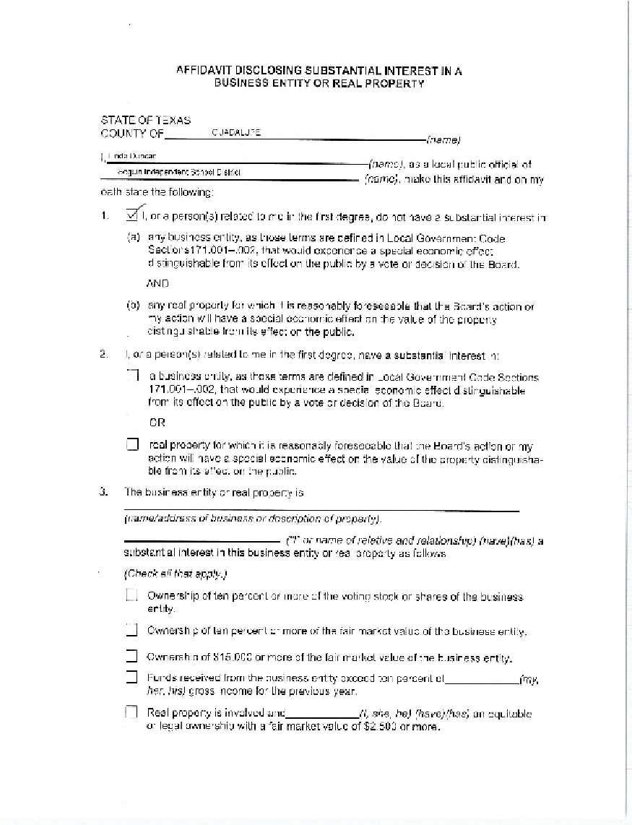
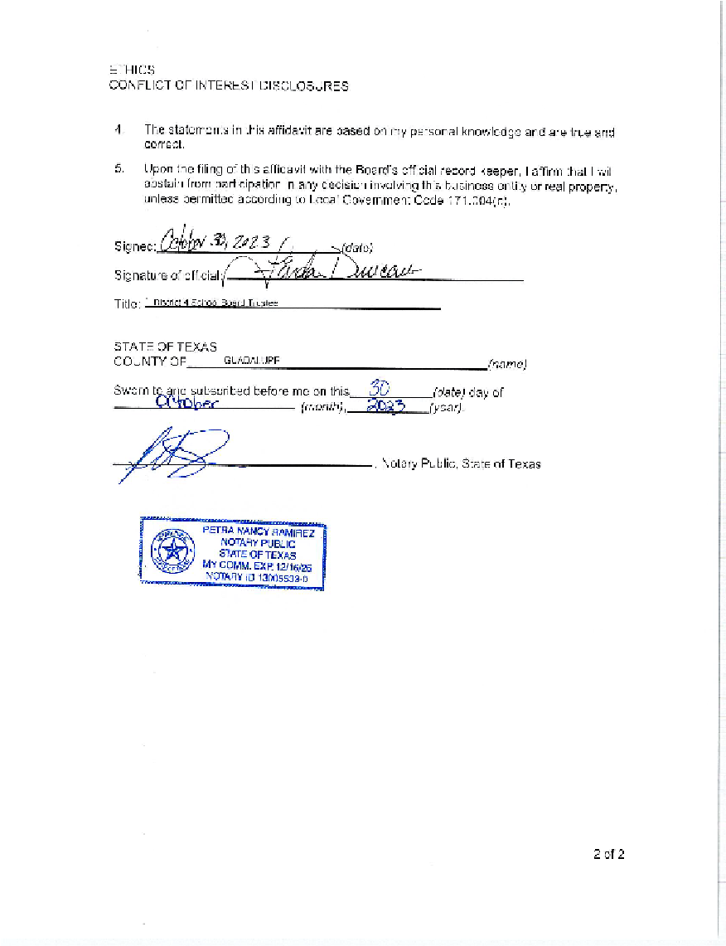
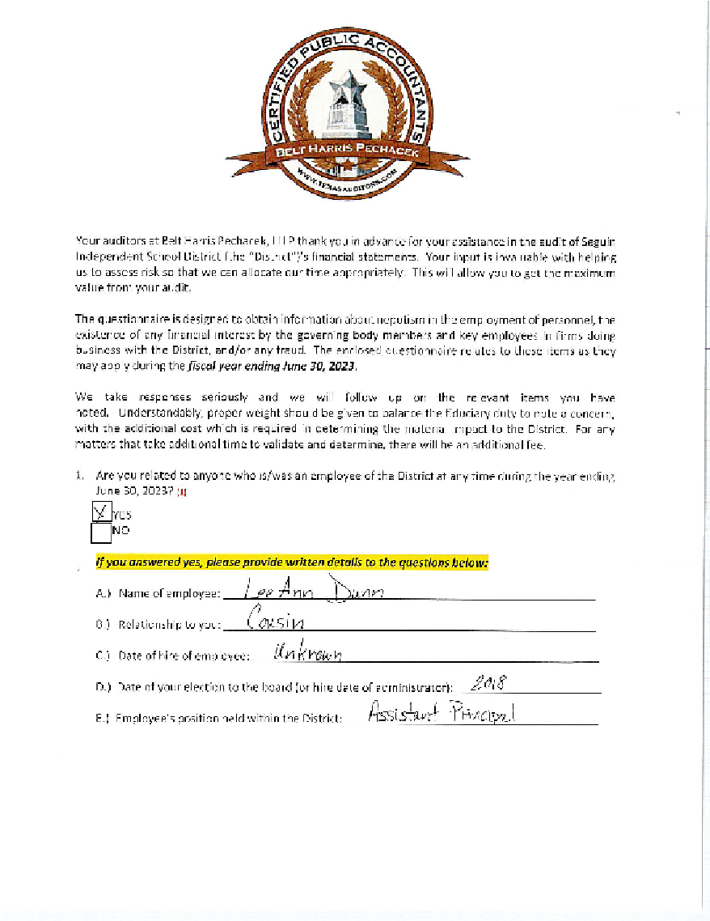
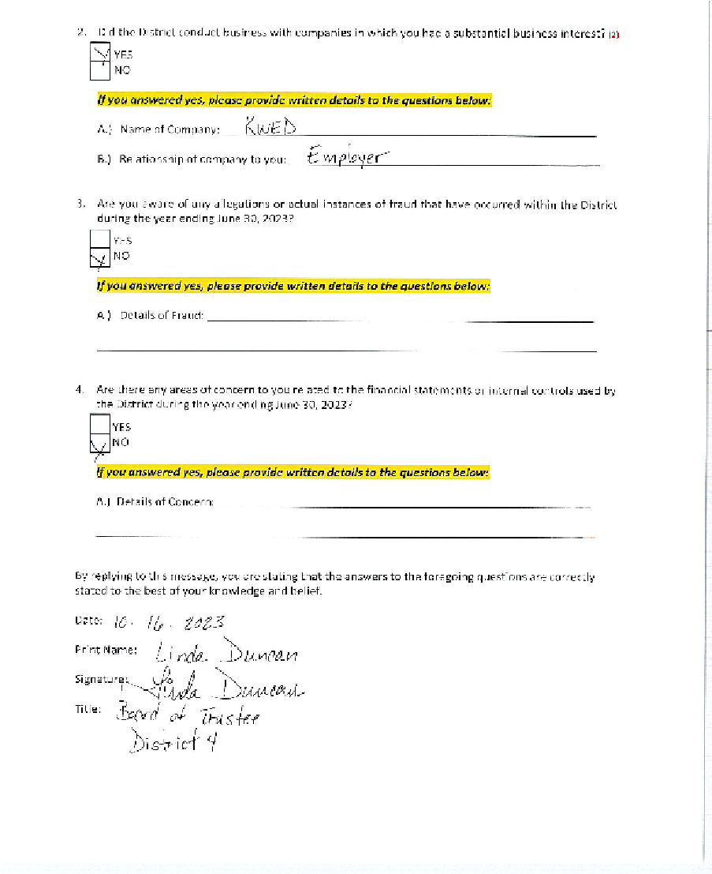


Slide 34
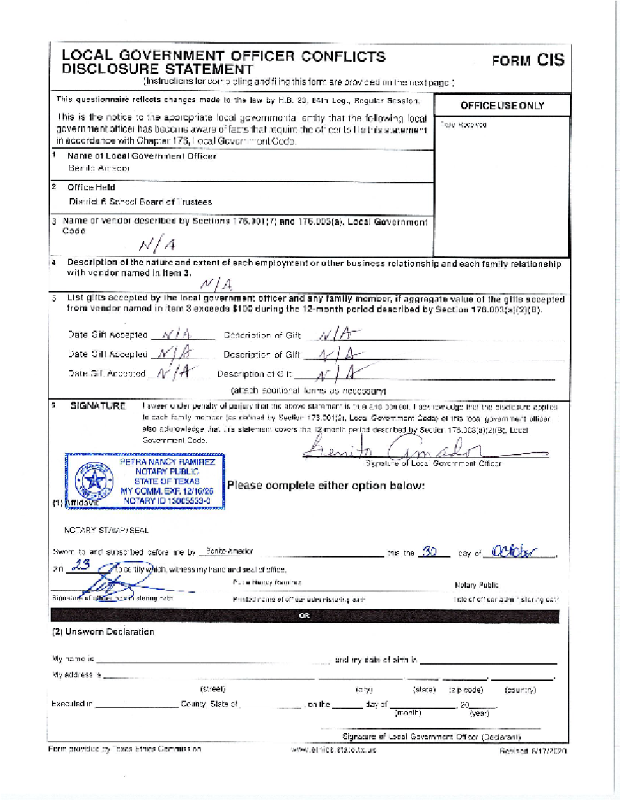
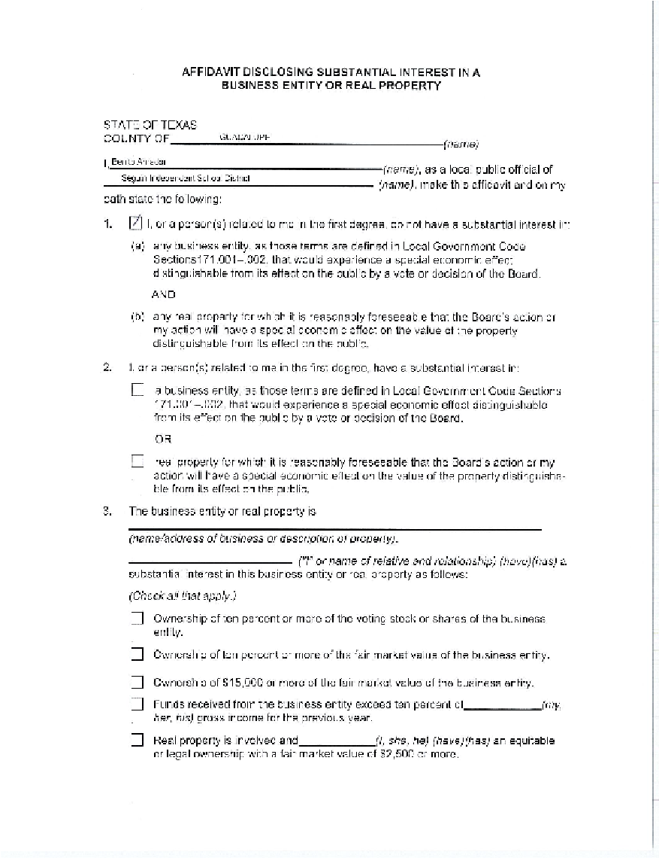
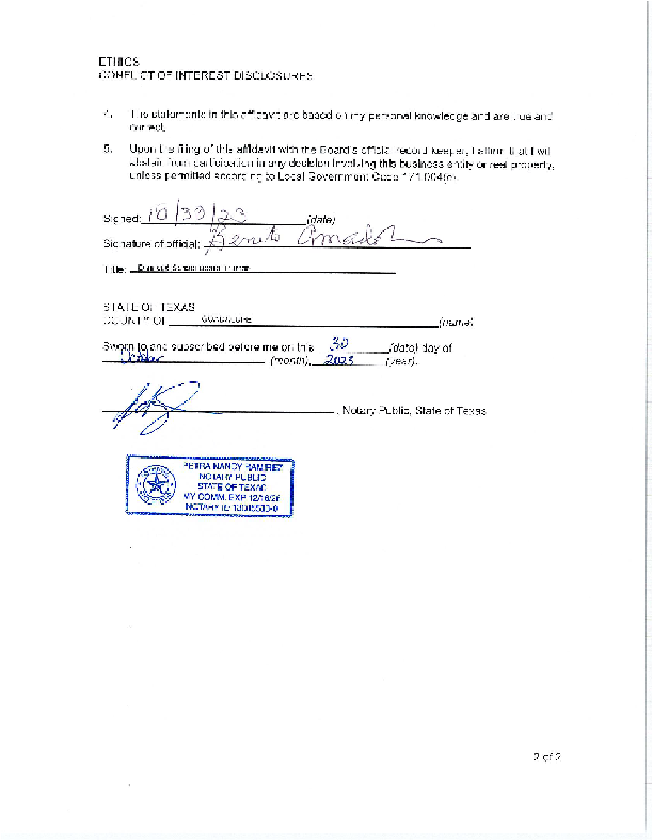
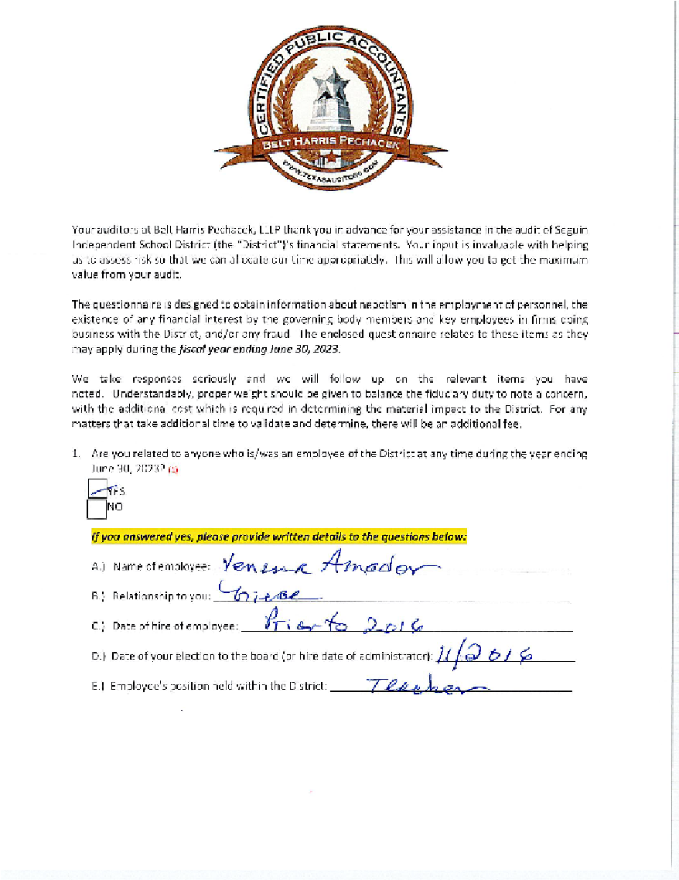
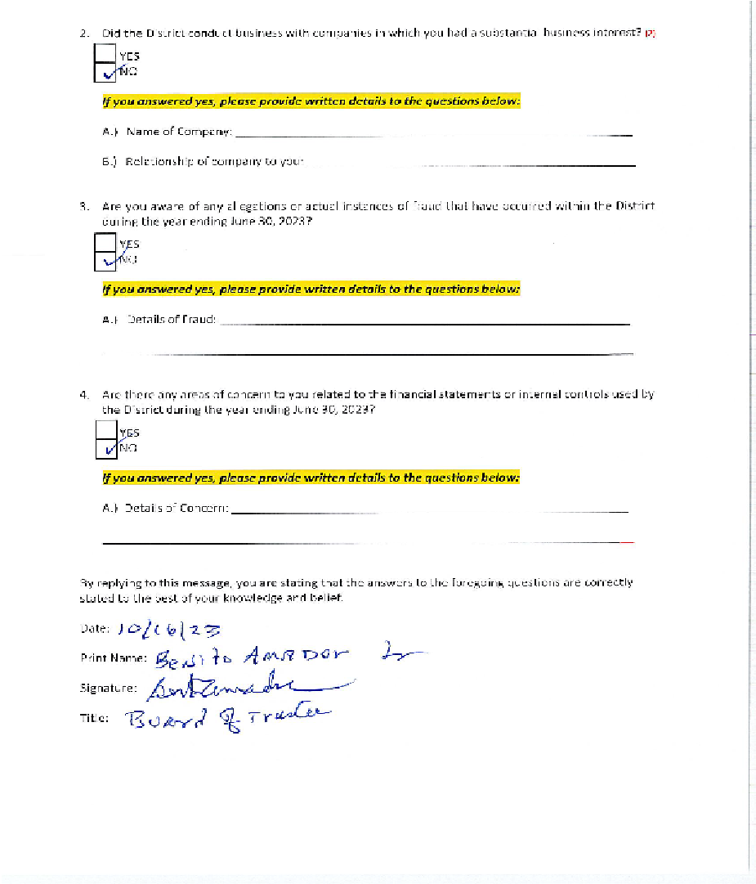
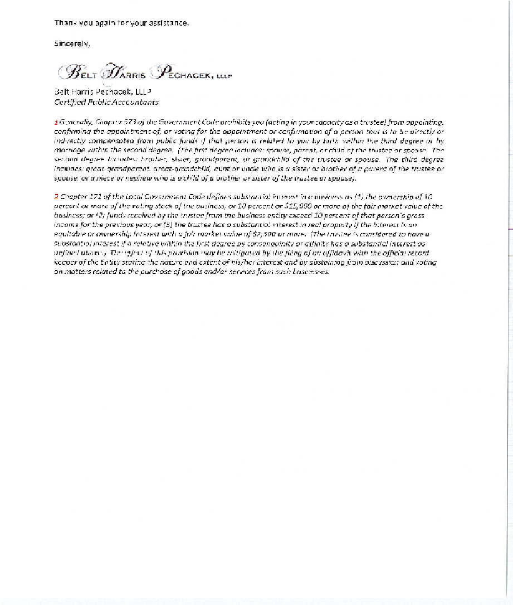

Slide 35
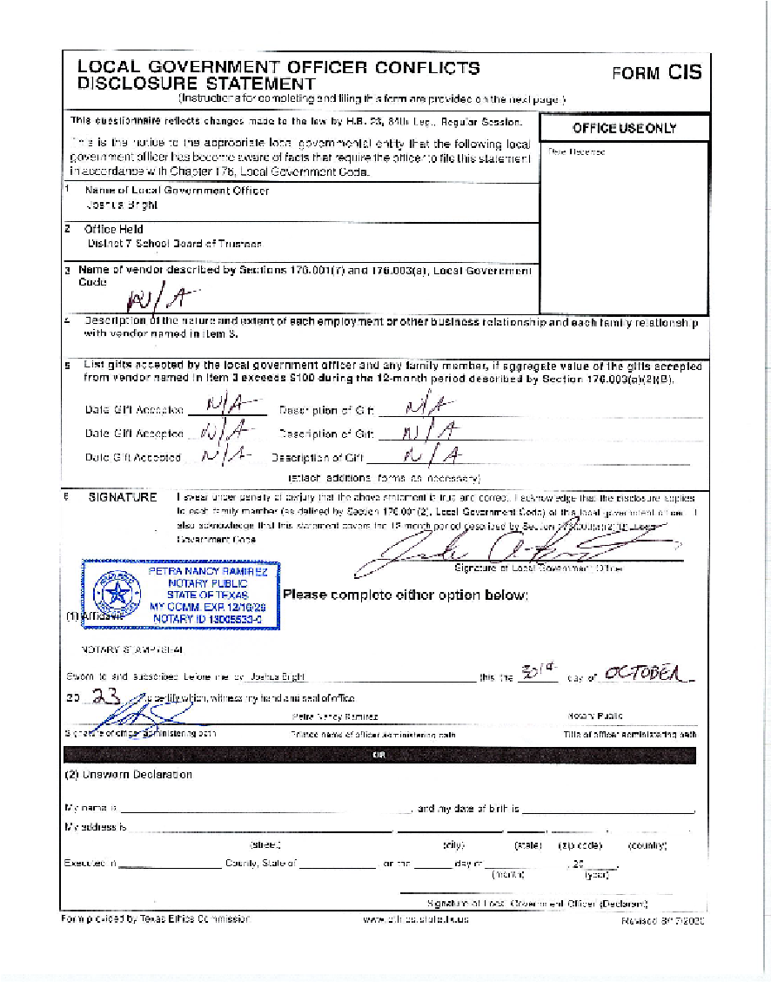
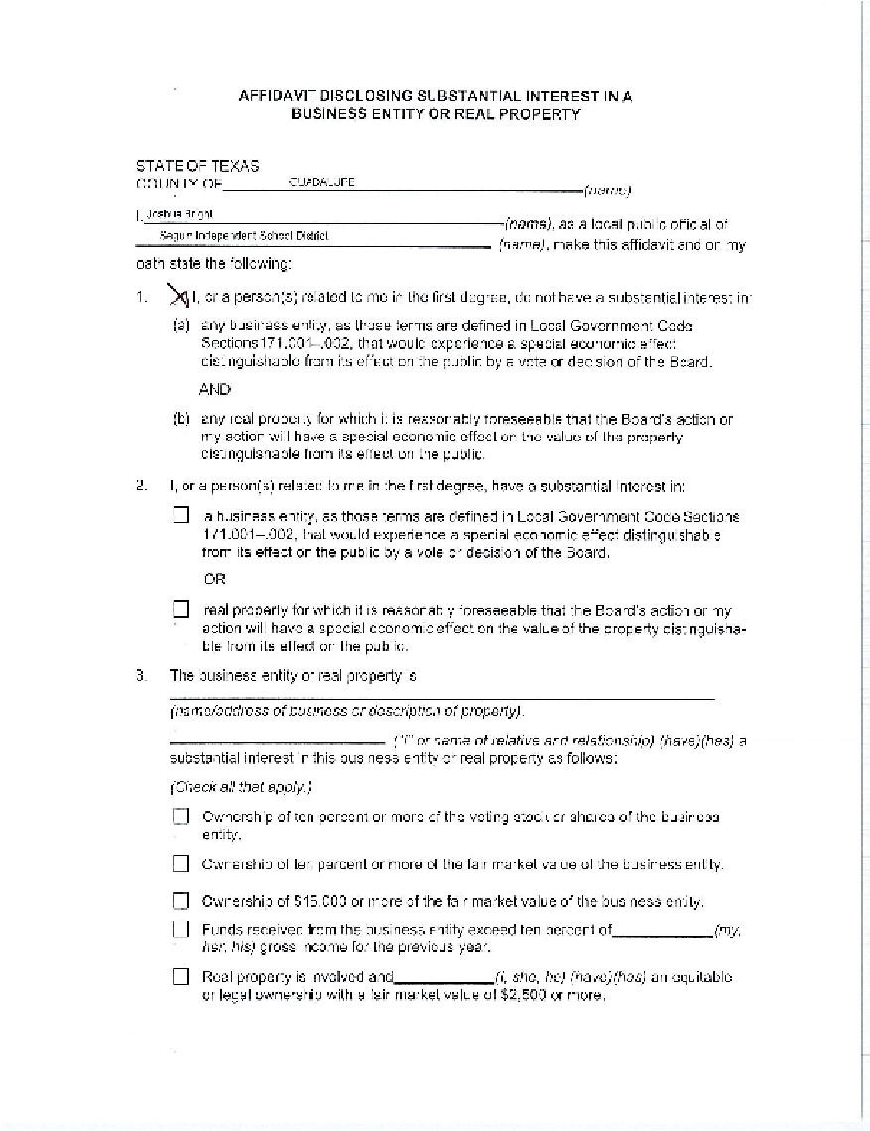
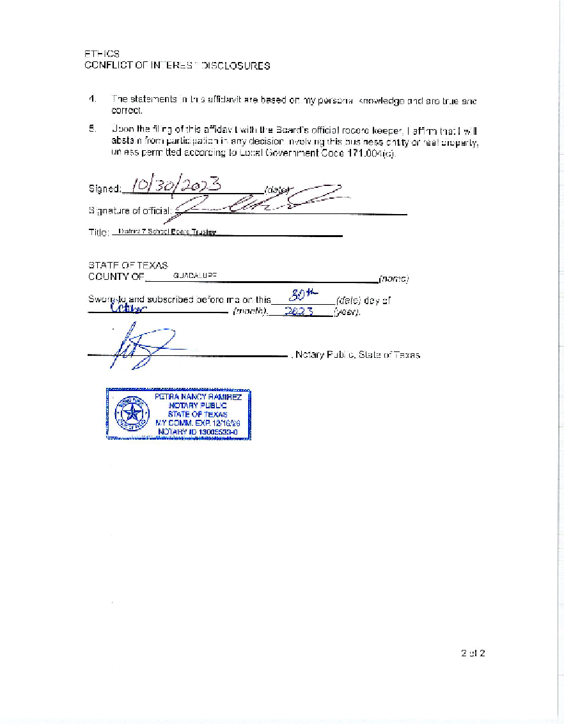
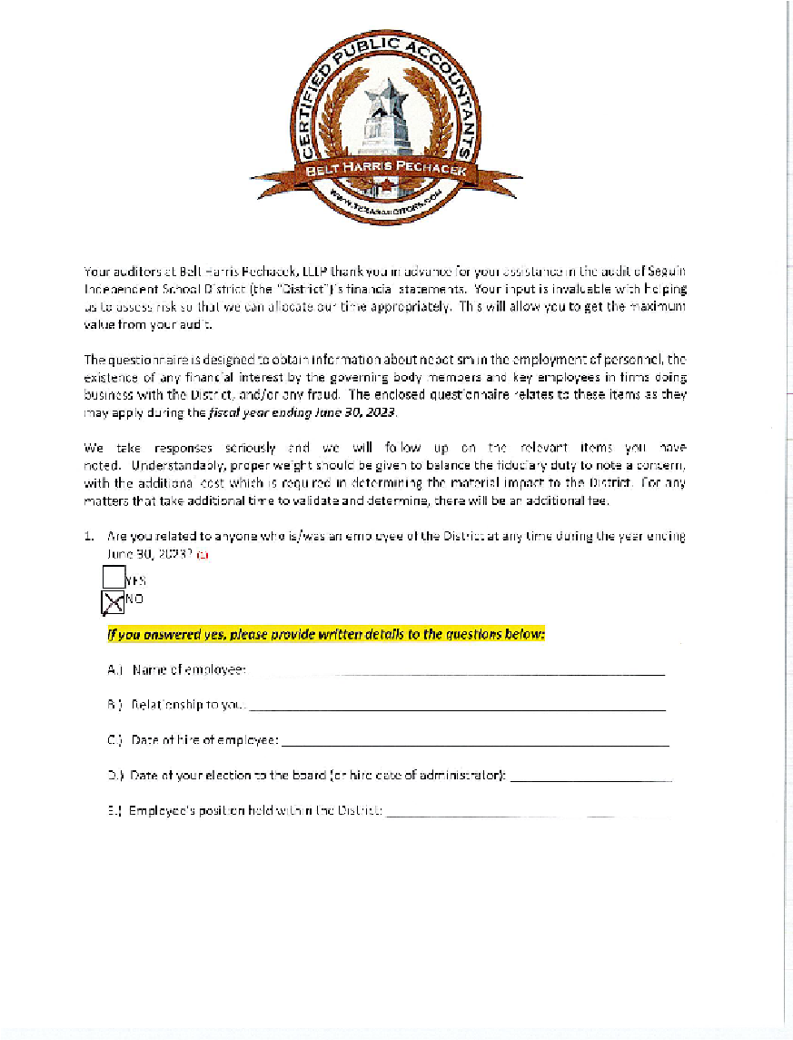
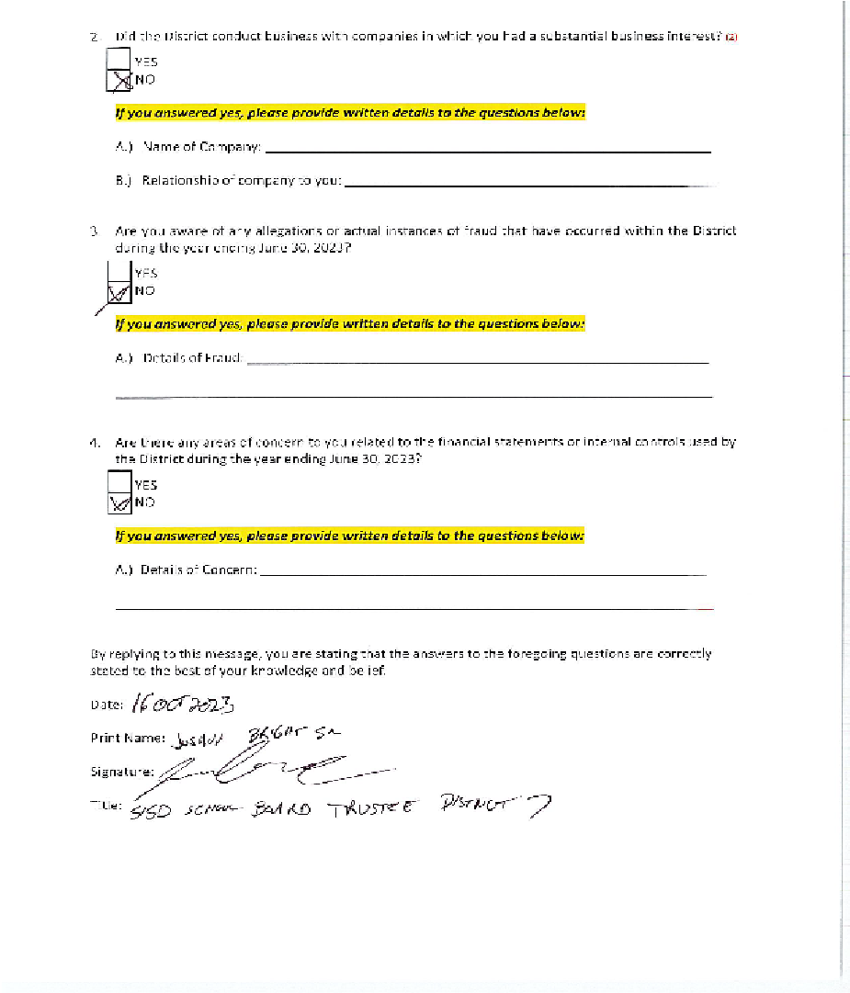
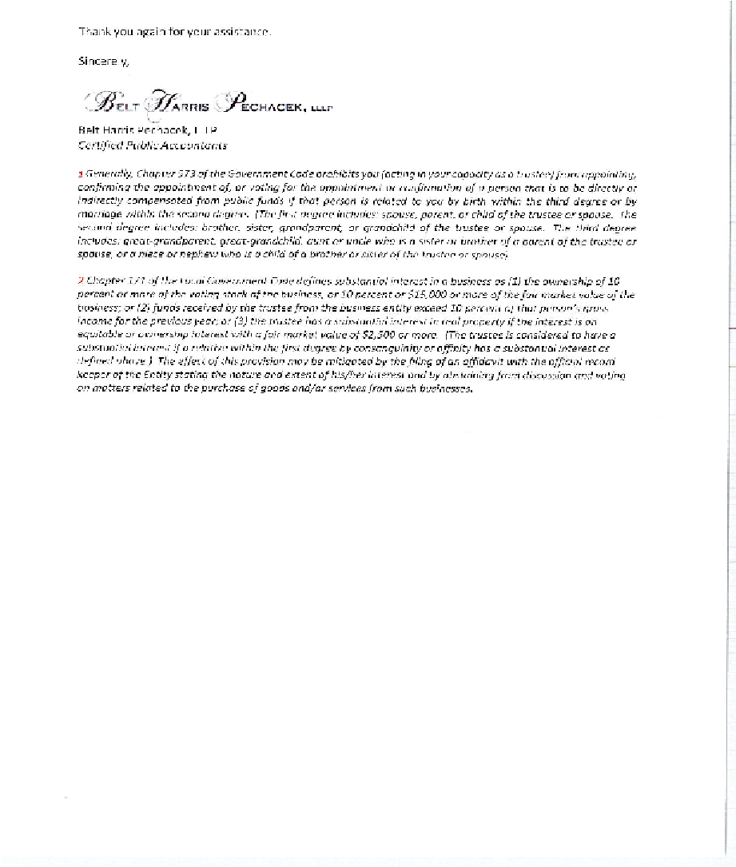

Slide 36
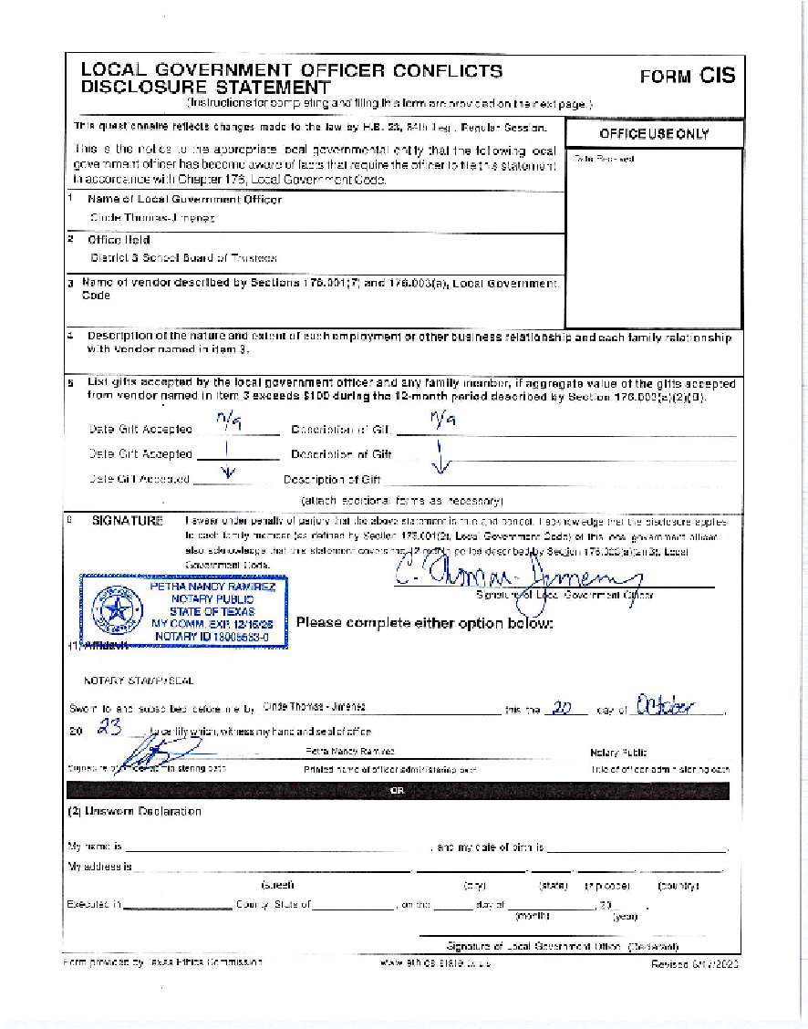
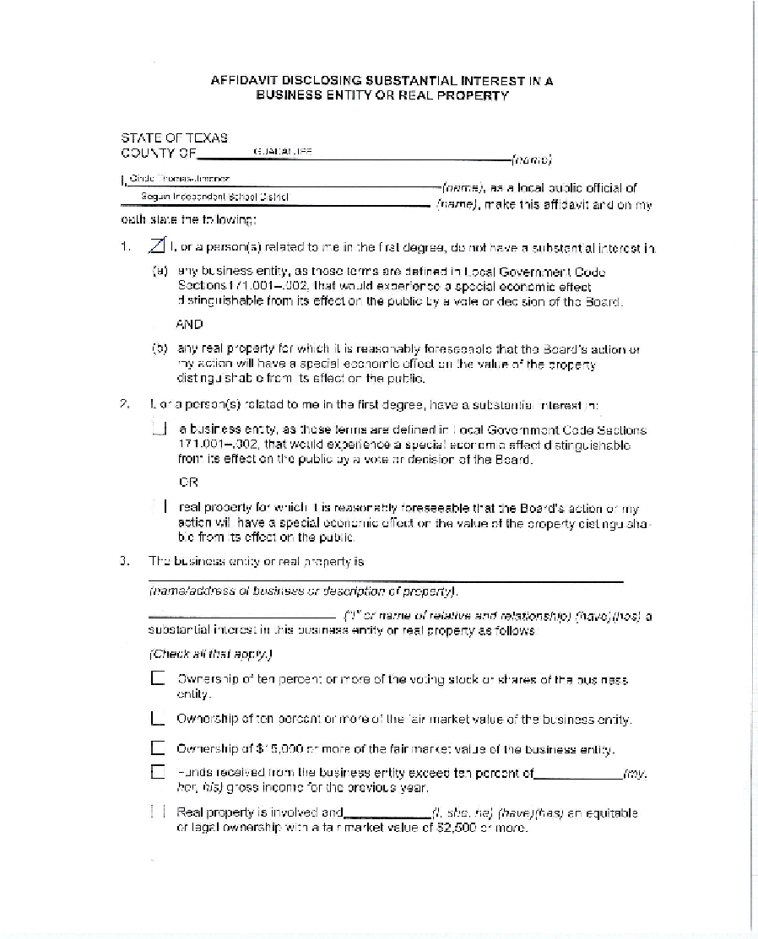
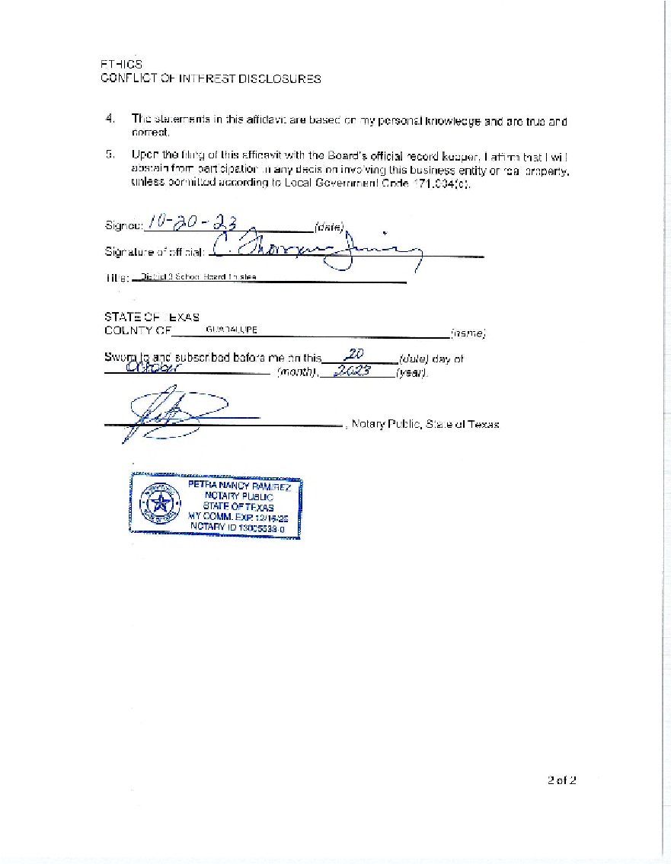

Slide 37
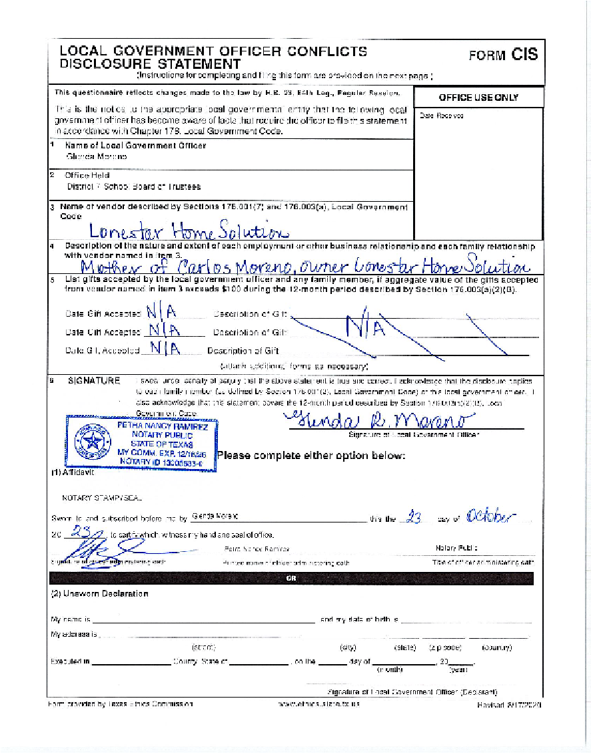
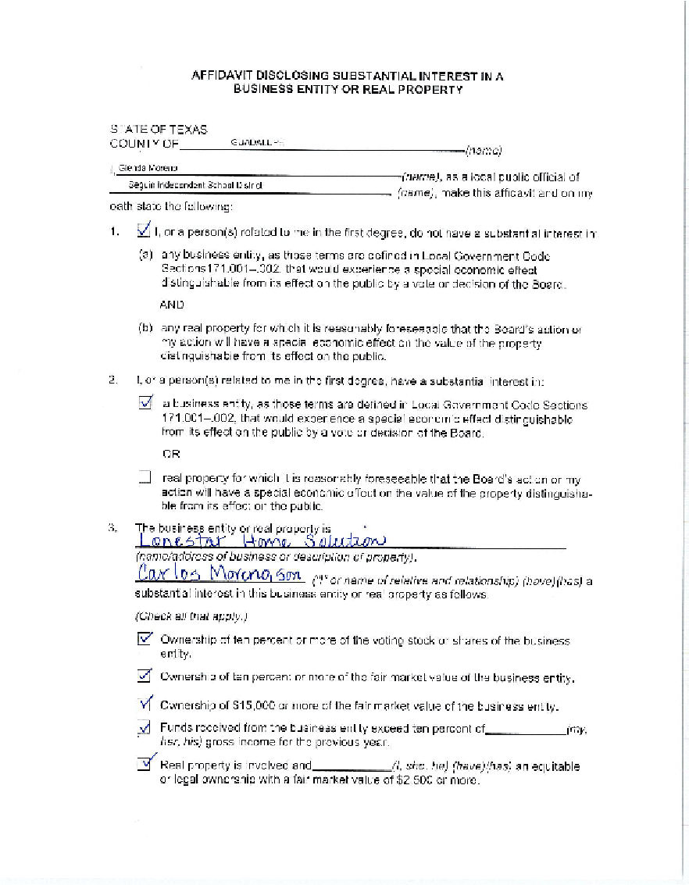
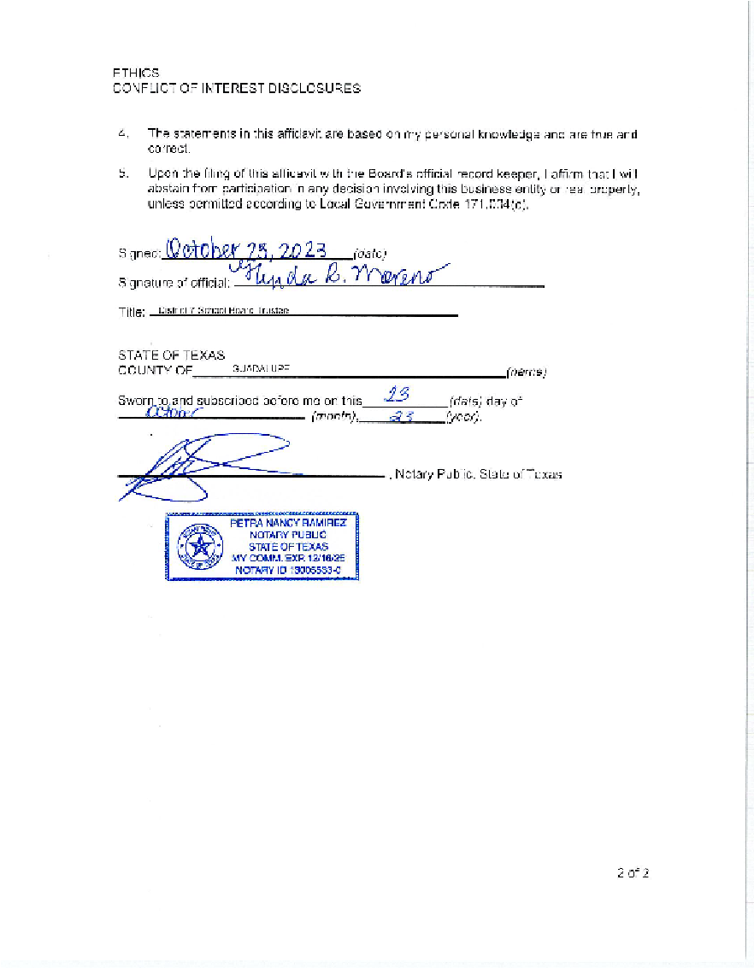

Slide 38
Seguin ISD
Business Department
Financial Integrity Rating System (FIRST) of Texas
Required Disclosure:
Official 2022-2023 FIRST Report from TEA

Slide 39
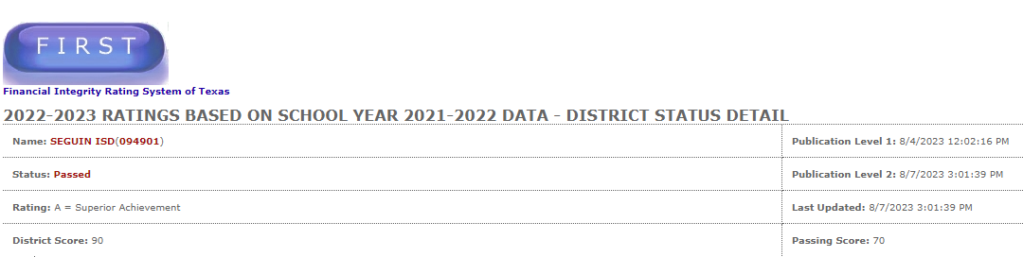

Slide 40
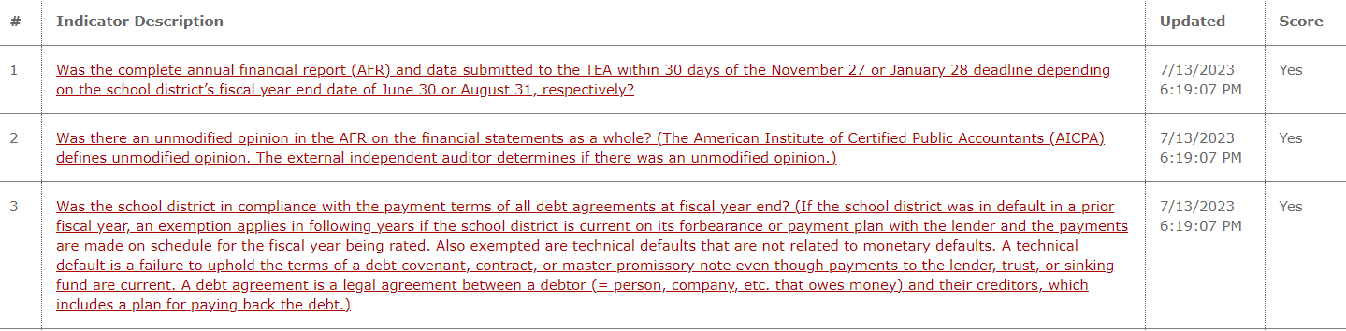

Slide 41
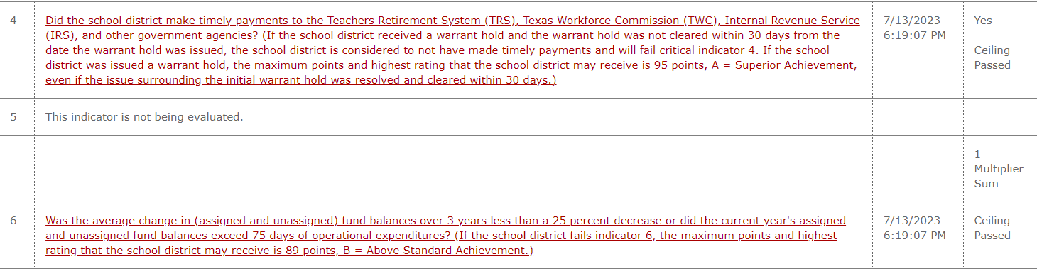

Slide 42
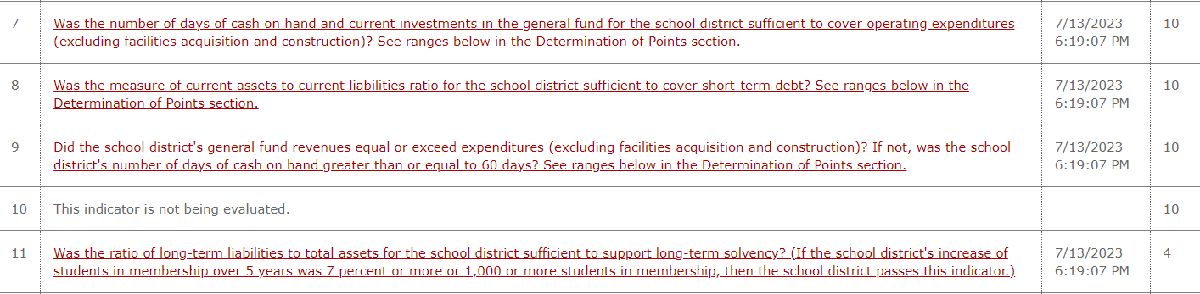

Slide 43
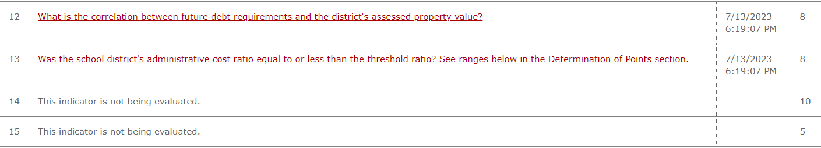

Slide 44
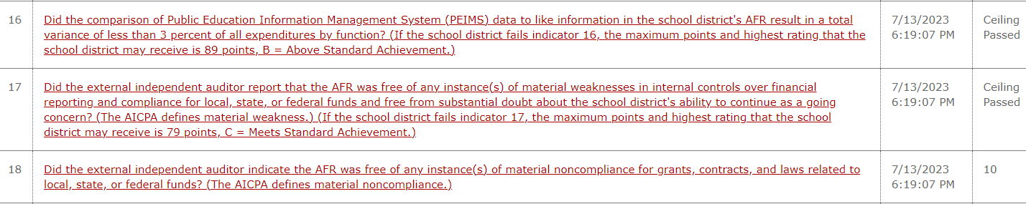

Slide 45


Slide 46


Slide 47


Slide 48
Seguin ISD
Business Department
Financial Integrity Rating System (FIRST) of Texas
Required Disclosure:
Superintendent’s Employment Contract
https://www.seguin.k12.tx.us/upload/page/0109/Supt%20Contract.pdf

Slide 49
Seguin ISD
Business Department
Financial Integrity Rating System (FIRST) of Texas
Questions?

